Slide 1


Automated Resume Filtering Using UiPath
- Arsh Syed | AXS220361

Slide 2


Problem Statement
The Resume Screening Bottleneck
Manual resume screening is time-consuming and error-prone
High risk of overlooking qualified candidates
HR teams struggle with inconsistent formatting, varied skill terms
Growing need for intelligent, unbiased, automated evaluation
Real-world formats include PDF, scanned docs, mixed layouts

Slide 3

Data Used & Complexity of the Data
Data Inputs: Real-World Resume Challenges
200+ resumes in varied PDF formats
Mix of structured, semi-structured, and image-based content
Resumes contain diverse layouts: columns, headers, sidebars
Skills, titles, and experience phrased inconsistently
Reference job descriptions provided as .txt files for matching

Slide 4
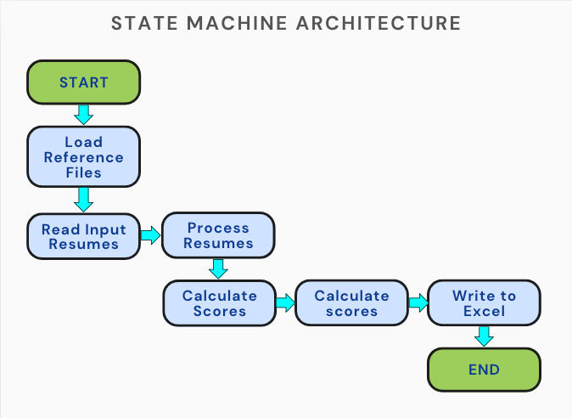
Project Architecture (State Machine Model)
Automation Workflow Overview
The resume filtering bot follows a clean and modular state machine-based architecture. Each resume is passed through a well-defined series of states. This approach enhances fault tolerance, makes error handling easier, and simplifies debugging.
Main States in the Workflow:
Start – Initializes environment variables and folders.
Load Reference Files – Reads the required job profile (.txt) for scoring reference.
Read Input Resumes – Loads and reads all the resumes from the designated folder.
Process Each Resume – Extracts text, parses skills, title, degree, and experience.
Calculate Scores – Uses a weighted formula to score the resume.
Write to Excel – Populates the final Excel sheet, sorted by highest score.
End – Final log write and clean exit.
The state machine model allows flexible transitions and skips failed resumes without halting the entire process.

Slide 5

Explanation of Automations Used
Automations Used – Key Techniques
State Machine Architecture for Workflow Control
Regex-Based Data Extraction
Skill Matching with Normalization
PDF Extraction with OCR Fallback
Designed the bot using UiPath's state machine model to manage each phase: Initialization, Resume Processing, Scoring, and Output. This made the bot modular, predictable, and easy to maintain or debug.
Used Read PDF Text for standard files. If that failed (e.g., image-based resumes), fallback to Read PDF with OCR using Tesseract ensured no resume was skipped due to format.
Applied regular expressions to dynamically extract key data like names, emails, titles, degree mentions, and years of experience. This gave flexibility across varied resume templates.
Converted both the reference skills and extracted text to lowercase and removed punctuation. This avoided mismatch due to variations like “Power-BI” vs “Power BI”. Used .Intersect() to identify matched skills from reference.
Excel Output Generation and Sorting
Weighted Scoring Logic for Ranking Candidates
Error Handling and Logging
Used Build DataTable + Write Range to generate final scores. Results were sorted using .DefaultView.Sort to rank candidates by descending scores.
All failures (e.g., unreadable resumes) were logged with timestamp. This ensured traceability and smooth unattended bot runs.
Each resume was scored based on:
Skills (40%)
Experience (40%)
Education (20%)
This weighting model mirrors real-world recruiter priorities.

Slide 6
Resume Scoring
Resume Scoring Logic – How Candidates Were Ranked
Skill Match Score (40%)
Compares extracted skills from resume vs required skills
Uses lowercase normalization and fuzzy matching
Penalizes short skill lists with scaled logic
Formula Example: (matchedSkills.Count / requiredSkillsArray.Count) * 100
2. Degree Score (20%)
Uses Regex pattern matching for keywords like “Master”, “Bachelor”, “Diploma”
Handles variants like “MSc”, “MBA”, “B.Tech”, etc.
Scoring: Master = 50, Bachelor = 30, Diploma = 15
3. Experience Score (40%)
Extracted using Regex or numeric parsing of years
Supports decimal years like 2.5, 4.8 etc.
Linearly scaled: Min(experienceYears, 15) * 2
4. Final Scoring Formula:
(SkillScore * 0.4) + (DegreeScore * 0.2) + (ExperienceScore * 0.4)

Slide 7

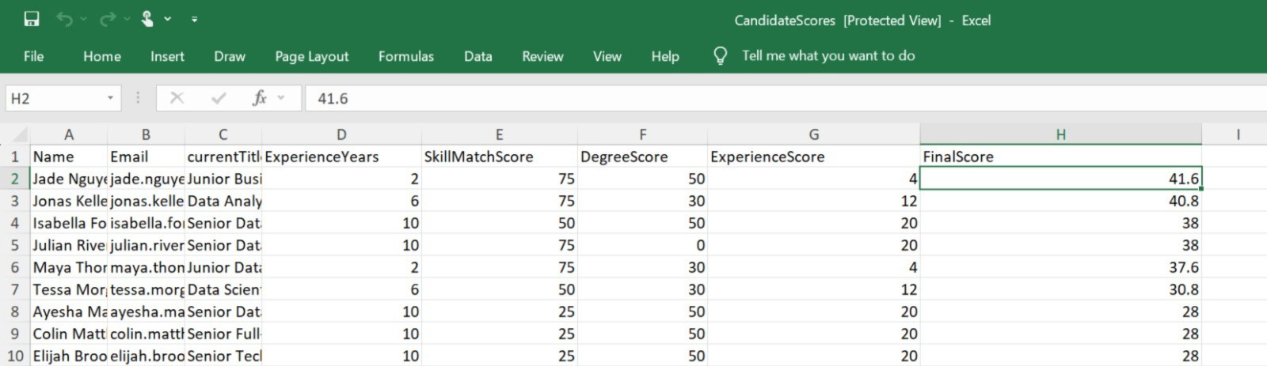
Output
Output Snapshot & Demo Reference
Your paragraph textOutput file: Clean Excel workbook, no manual formatting needed
Automatically sorted by Final Score (highest to lowest)
Includes extracted and computed data side-by-side
Reusable and extendable with new resumes
“Watch the bot process multiple resumes in real-time and generate ranked output.”

Slide 8
Challenges & Solutions
What Went Wrong - and How I Fixed It
1. Resume Layout Inconsistencies - Some resumes had creative designs—sidebars, icons, and unusual section orders. These disrupted both string parsing and OCR.
2. Skill Name Variations
Matching skills like "Power BI" vs. "powerbi" vs. "Power-BI" was tricky.
3. Final Score Not Sorted Initially- Early test runs produced unsorted output, making top candidates hard to spot.
Fix: Normalized skills by converting all to lowercase and stripping non-alphanumeric characters before comparison.
Fix: Implemented flexible keyword anchors (e.g., "Skills", "Experience") and fallback regex patterns to locate information regardless of position.
Fix: Added logic to sort the DataTable by FinalScore descending before writing to Excel.
4. OCR for Scanned PDFs -
Some resumes were images, not text-based PDFs, breaking string operations.
5. Debug vs. Full Run Discrepancies.
Some variables behaved differently in debug mode vs. full runs.
6. Skill Section Sometimes Missing - Skill Section Sometimes Missing
As our organization grows, our processes need to be scalable. RPA will provide the flexibility to adapt to changing workloads and requirements, ensuring long-term sustainability.
Fix: Integrated OCR fallback using UiPath's Tesseract OCR to extract data when text scraping failed.
Fix: Declared and initialized all variables explicitly, added safety checks for null values.

Slide 9
Testing & Enhancements
Tested for reliability and enhanced based on findings
1: Testing Approach
2: Security Measures
3: Enhancements Added
4: Impact
Unit testing of regex and filters in Studio debug mode
Simulated runs on small resume batches
Full-scale testing on 140+ resumes to ensure stability
Dynamic folder paths using GetCurrentDirectory
Protected resume parsing with Try-Catch
No sensitive info stored or shared externally
Smarter experience parsing with regex fallback
Degree recognition extended (e.g., MBA, B.Tech)
Sorted Excel output by FinalScore
Logs with timestamps for skipped/processed files
Bot became robust, scalable, and resume-agnostic
Ready for unattended automation in real use-cases

Slide 10
Conclusion & Next Steps
Final Thoughts + Future Improvements
Final Reflections
Building this bot was both challenging and rewarding
I developed a strong understanding of document parsing, regex, and real-world bot logic
Learned to think from the perspective of HR professionals while building tech
Future Improvements
Add NLP-based parsing using ML models (e.g., spaCy, OpenAI)
Integrate job descriptions dynamically via form input
Support multi-language resumes and image-heavy formats
Publish as an unattended robot for real-time screening

Slide 11




ThankYOu & Keep automating

